Slide 1



Stormwater Regulations

Slide 2
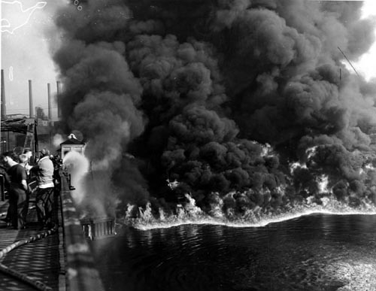
“The Solution to Pollution is Dilution”

Slide 3
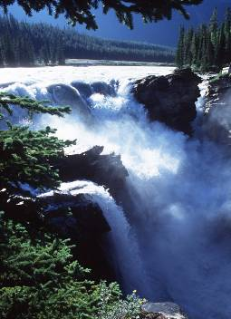
The Clean Water Act
1972, 1977
The cornerstone of surface water quality
protection in the United States …
… gave EPA the authority to implement pollution control programs and
... established the basic structure for regulating discharges of pollutants into the waters of the United States

Slide 4
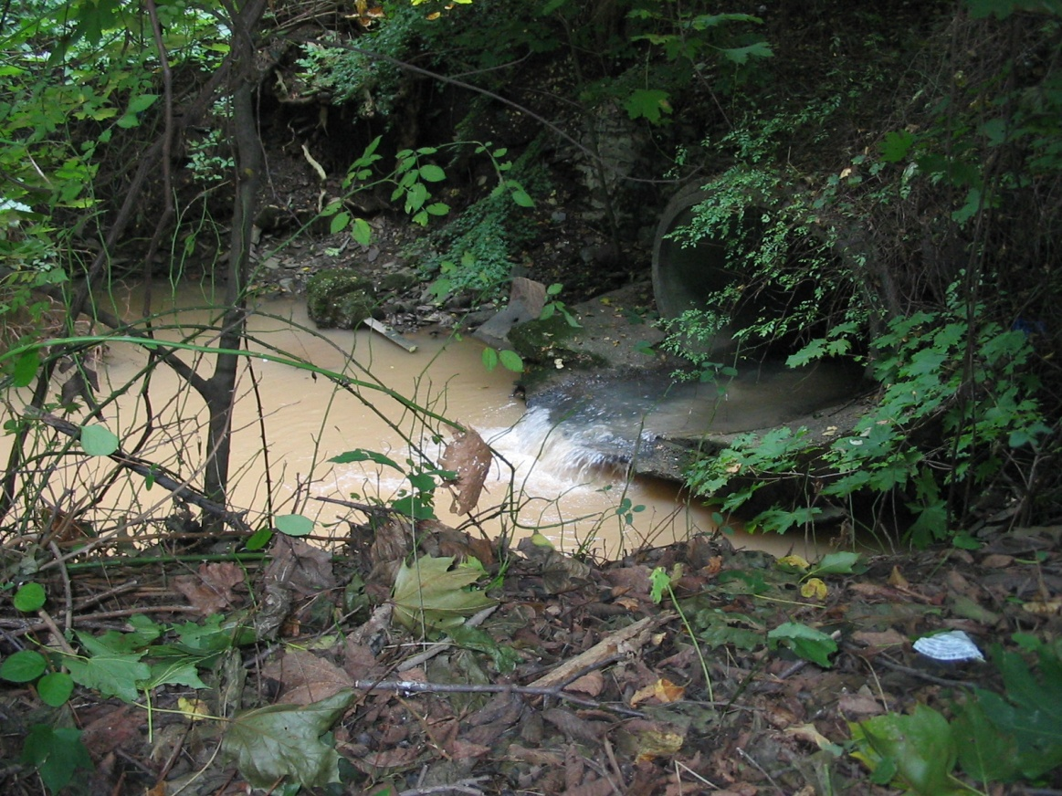
National Pollutant Discharge Elimination System
NPDES Permit:
A permit issued by EPA (ADEQ) that authorizes the discharge of pollutants to the waters of the United States

Slide 5
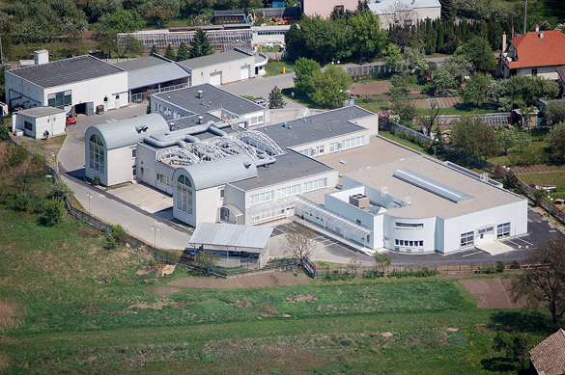

Slide 6
Phase I Storm Water Regulations
In 1990, EPA’s Storm Water Phase I program addressed storm water runoff from:
Ten categories of industrial activity:
  Manufacturing facilities, mining operations, disposal sites, recycling yards, transportation facilities, etc.
Category Nine (ix): Treatment works treating domestic sewage with a design flow of 1 million gallons a day or more

Slide 7
Phase I Storm Water Regulations
In 1990, EPA’s Storm Water Phase I program addressed storm water runoff from:
Ten categories of industrial activity
“Medium” and “ large” municipal separate storm sewer systems (MS4s) generally serving a population of 100,000 or more

Slide 8


Slide 9
Phase I Storm Water Regulations
In 1990, EPA’s Storm Water Phase I program addressed storm water runoff from:
Ten categories of industrial activity
“Medium” and “ large” municipal separate storm sewer systems (MS4s) generally serving a population of 100,000 or more
Construction activity disturbing 5 acres of land or greater

Slide 10
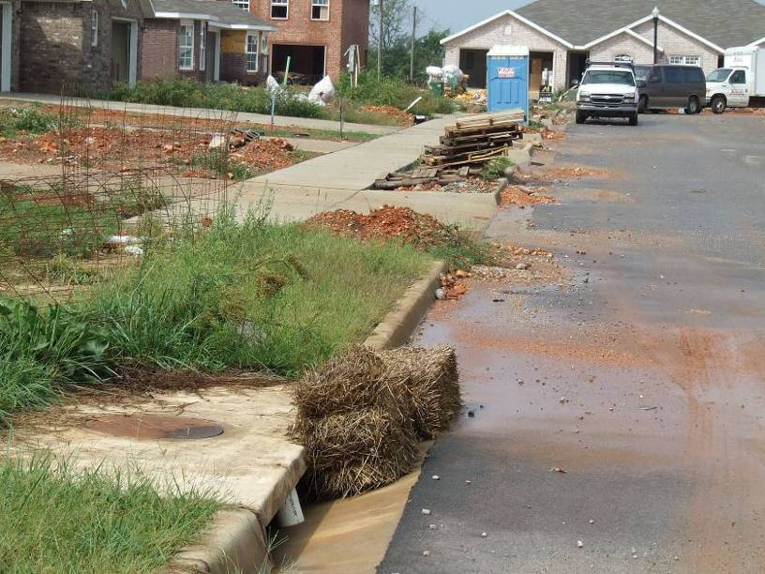

Slide 11
Phase II Storm Water Regulations
In 2003, EPA’s Storm Water Phase II program expanded the Phase I program by addressing stormwater runoff from:
“Small” municipal separate storm sewer systems (MS4s) generally serving a population of 10,000 or more or “urbanized areas”

Slide 12
Arkansas MS4 Cities and Counties

Slide 13
Phase II Storm Water Regulations
In 2003, EPA’s Storm Water Phase II program expanded the Phase I program by addressing stormwater runoff from:
“Small” municipal separate storm sewer systems (MS4s) generally serving a population of 10,000 or more or “urbanized areas”
Construction activity disturbing 1-5 acres of land or greater

Slide 14
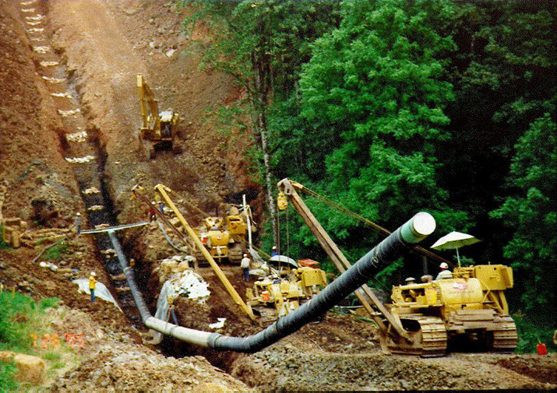
Linear Construction Projects

Slide 15
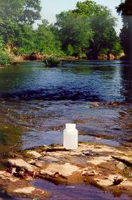
Regulatory Authority Hierarchy
Clean Water Act
(Congress)
Code of Federal Regulations
(EPA)
NPDES Permits
(Arkansas Department of Environmental Quality)
Policy and Guidance
(local ordinances)

Slide 16
Remind me again…
What does this have
to do with me?!?

Slide 17

You are a member of a community that
depends on shared water resources
Craighead Forest Lake

Slide 18
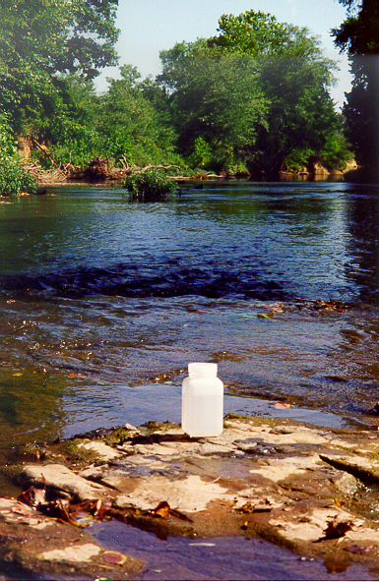
Stormwater management is required
by federal and state laws
Stormwater Program
City Water & Light has a federally mandated stormwater NPDES permit that outlines how it will manage its stormwater runoff at the Jonesboro Westside Wastewater Treatment Plant

Slide 19
Failure to comply is a violation of the
Clean Water Act
Each violation of a particular requirement
can be the subject of a separate penalty
These can include civil and criminal penalties,
punishable by fine and/or incarceration
$$$

Slide 20
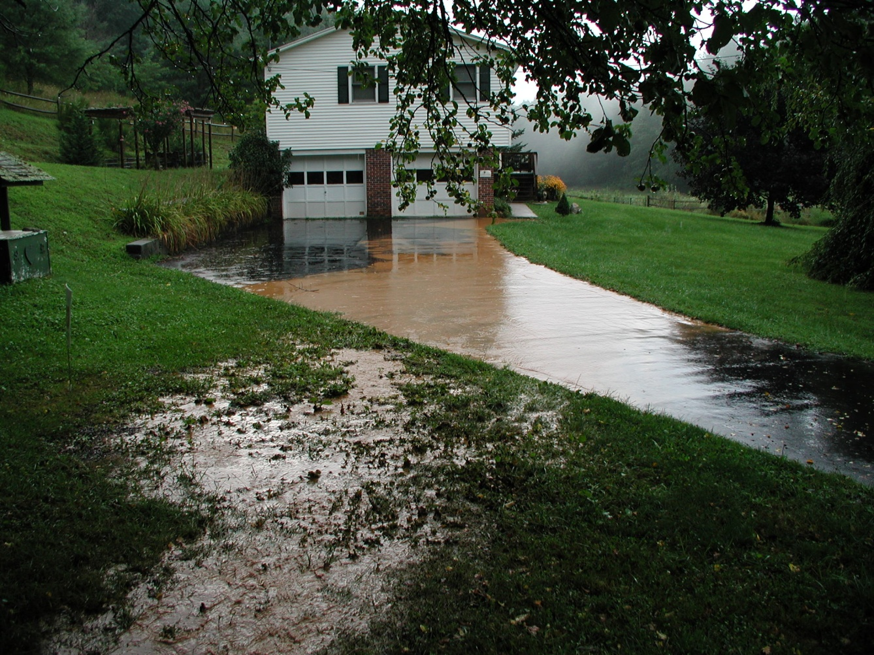
Ultimately, you could be liable
in a 3rd party lawsuit

Slide 21

Now a bit more about industrial stormwater management…

Slide 22
Industrial Stormwater Permitting
Engineering Staff
Jamal Solaimanian, P.E. 501-682-0620
Engineering Supervisor
Amanda Gallagher 501-682-0621
Engineer
Jennifer Harmon 501-682-0627
Engineer
Nicholas Willis 501-682-0619
Engineer

Slide 23

Stormwater Discharges Associated With Industrial Activity
Stormwater discharges associated with an industrial activity as defined in 40 CFR 122.26(b)(14)(i) – (xi) are required to obtain coverage under the Industrial Stormwater General Permit ARR000000.

Slide 24

General Requirements of the Industrial Stormwater General Permit

Slide 25
Who is Covered???
Breaks down industries into sectors that are based on Standards Industrial Classification (SIC) code or by industry activity category…
SECTOR R: SHIP AND BOAT BUILDING AND REPAIRING YARDS
R1 3731, 3732 Ship and Boat Building or Repairing Yards
SECTOR S: AIR TRANSPORTATION FACILITIES
S1 4512-4581 Air Transportation Facilities
SECTOR T: TREATMENT WORKS
T1 TW Treatment Works treating domestic sewage or any other sewage sludge or wastewater treatment device or system, used in the storage, treatment, recycling, and reclamation of municipal or domestic sewage, including land dedicated to the disposal of sewage sludge that are located within the confines of the facility, with a design flow of 1.0 mgd or more, or required to have an approved pretreatment program under 40 CFR Part 403. Not included are farm lands, domestic gardens or lands used for sludge management where sludge is beneficially reused and which are not physically located in the confines of the facility, or areas that are in compliance with section 405 of the CWA

Slide 26
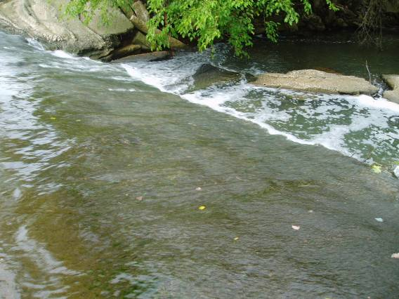
What does stormwater pollution management mean for Jonesboro City Water & Light?

Slide 27
Stormwater Program Requirements
Apply for NPDES permit coverage
Develop a Stormwater Pollution Prevention Plan (SWPPP)
Implement the SWPPP using appropriate Best Management Practices (BMPs)
Develop measureable goals for the program
Evaluate and report effectiveness of the program

Slide 28
No Exposure Exclusion
Exists at an industrial facility when all industrial materials and activities are protected from exposure to rain and/or runoff. Industrial materials or activities include, but are not limited to, material handling equipment or activities, industrial machinery, raw materials, intermediate products, by-products, final products, or waste products.

Slide 29
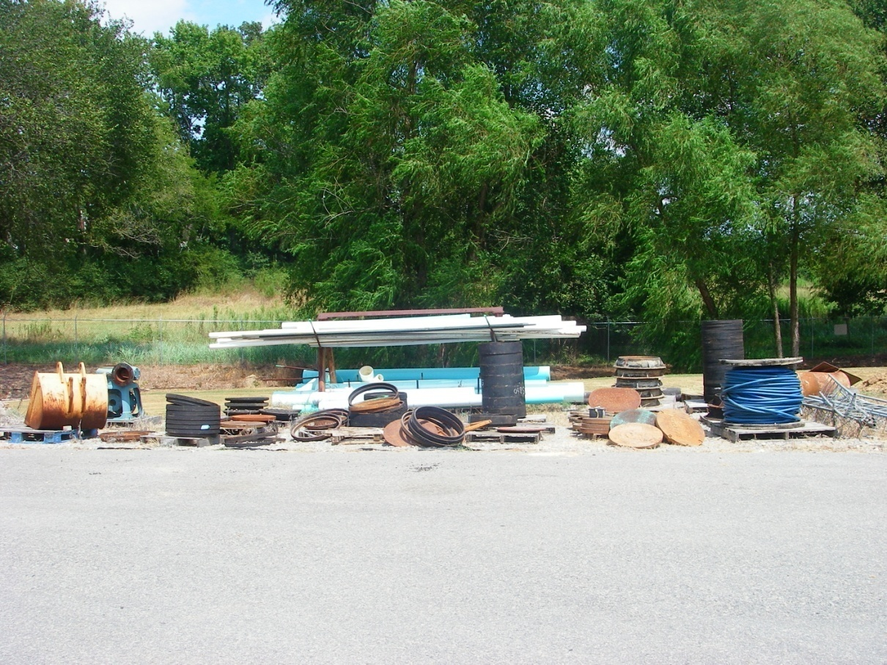
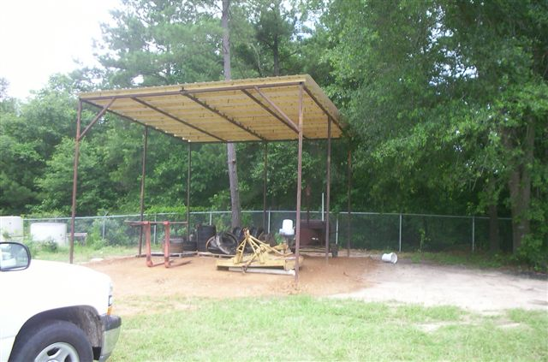
Scrap areas must either be cleaned up or covered.
Here is an option for cover

Slide 30
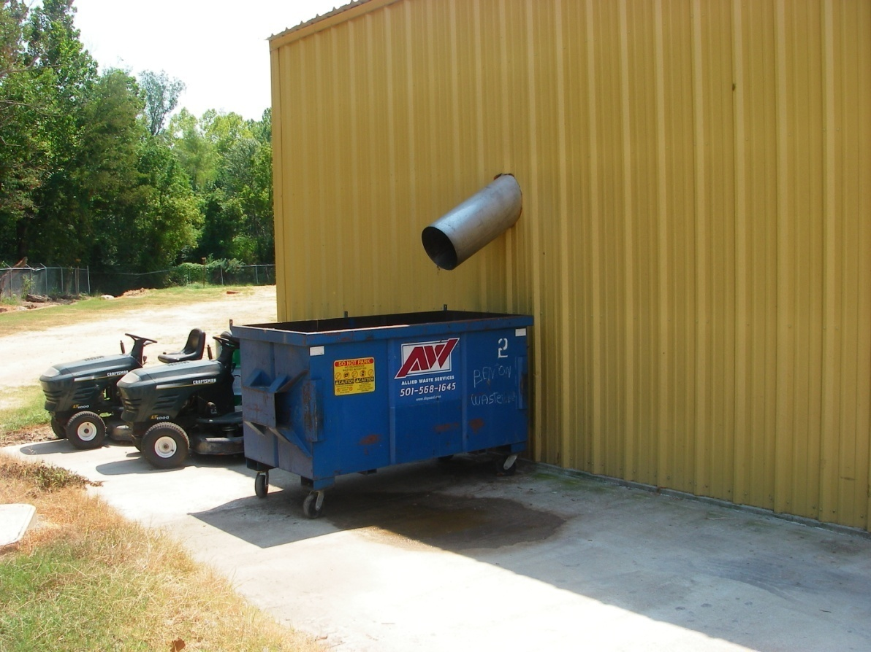
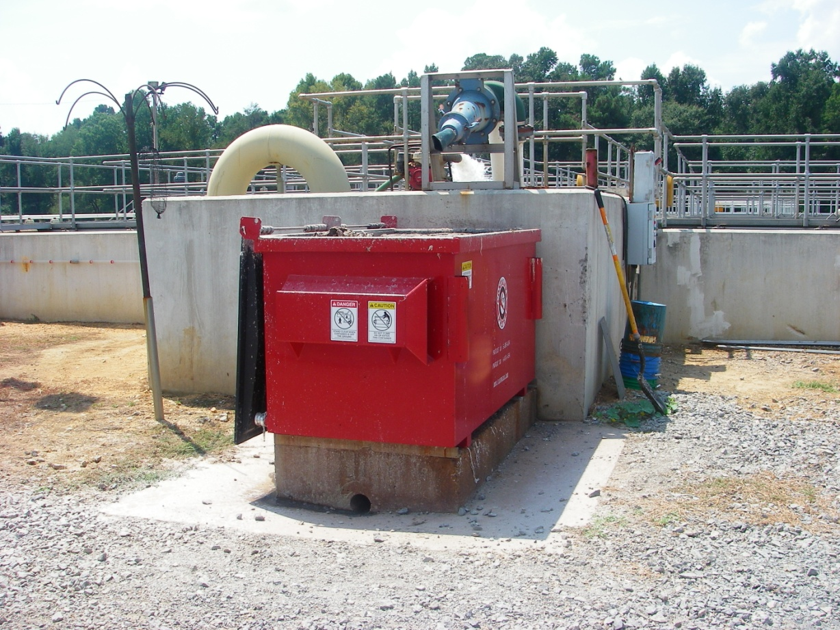
Dumpsters must either be covered or drain back to treatment
This dumpster drains back to treatment

Slide 31

Inspections
Perform comprehensive site evaluation and site inspection annually

Slide 32
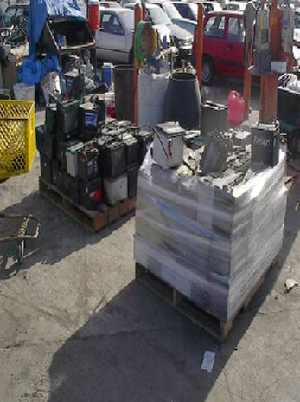
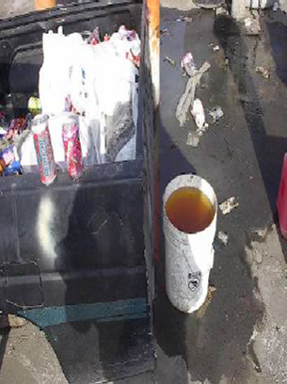
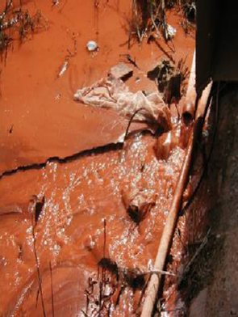
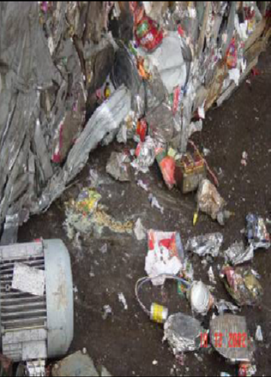
Exposure of Potential Pollutants
Spills and Leaks
Un-authorized Non-stormwater Discharges
Poor Housekeeping

Slide 33
Looking Forward…
The Department will notify all existing permittees via correspondence when the appeal has been resolved.

Slide 34
Current Permit
Current Industrial General Permit (IGP) Expired March 31, 2009
The Renewal Permit was issued June 30, 2009 with an effective date of July 1, 2009
The Renewal Permit was appealed by the Arkansas Environmental Federation on July 29, 2009 and thus stayed

Slide 35
Current Permit cont’d...
On March 26, 2010, the APCEC lifted the stay on the IGP per a Minute Order until a final decision was made on the appeal (62-page AR000000 permit and minute order.pdf)
The 2009 IGP became effective immediately, except for those sections that are the subject of the appeal
Alternative terms and conditions were applied in the place of the sections that remained stayed

Slide 36
Obtaining Renewal Permit Coverage for Existing Permittees
Within 180 days of the effective date of the Minute Order – September 26th, 2010:
Submit completed NOI
and
Update SWPPP, as necessary, to comply with the requirements of renewal permit (do NOT submit SWPPP)

Slide 37
Stormwater Pollution
Prevention Plan (SWPPP)
SWPPP must match the renewal permit
SWPPP Changes:
  Facility Information
  New Control Measure - Minimize Exposure
  Sara Title 313 section has been removed
  Format has been rearranged

Slide 38
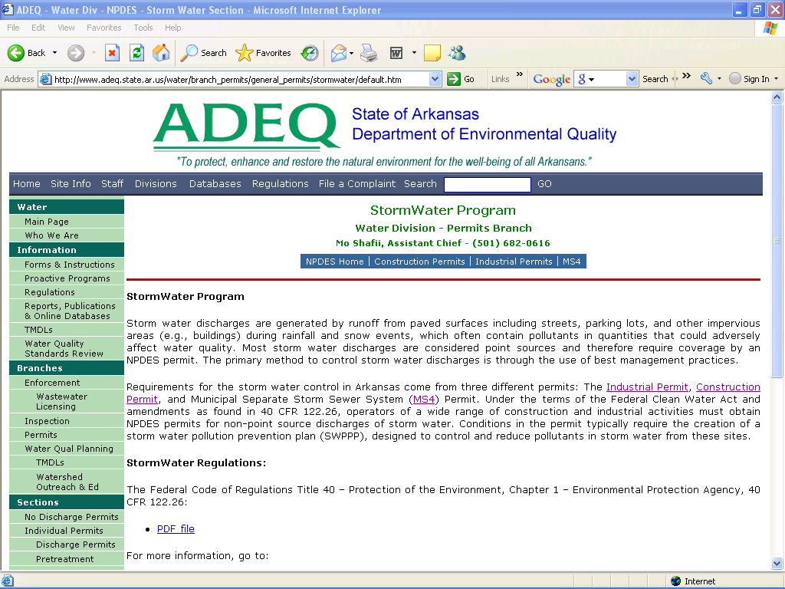
www.adeq.state.ar.us
Find the NOI and other forms in the Water Division web pages

Slide 39

Questions?

Slide 40
Where to Submit
By snail mail to:
General Permits Section
Water Division
Arkansas Department of Environmental Quality
5301 Northshore Drive
North Little Rock, AR 72118
or by electronic mail
Complete documents must be submitted in Adobe Acrobat .pdf to: Water-permit-application@adeq.state.ar.us

Slide 41
Effluent Limitations Guidelines (ELGs) for Stormwater
Additional facilities under the following ELG’s are now allowed to discharge under the Industrial Stormwater Permit
Regulated Discharge | 40 CFR Section
Runoff from material storage piles at cement manufacturing facilities | Part 411, Subpart C
Runoff from phosphate fertilizer manufacturing facilities that comes into contact with any raw materials, finished product, byproducts or waste products (SIC 2874) | Part 418, Subpart A
Runoff from coal storage piles at steam electric generating facilities | Part 423
Runoff from asphalt emulsion facilities | Part 443, Subpart A
Only one in previous permit

Slide 42
Effluent Limitations Guidelines (ELGs) for Stormwater
Not all ELG’s for Stormwater are included
Grab Sample – Annual Sampling
Permit Limitations – are enforceable

Slide 43
Parameter Benchmark Monitoring Requirements
Stormwater Sampling for 12 monitoring categories of industries.
    SARA Title III
    Primary Metals
    Wood Treatment, etc.
Monitoring Frequency:
Annually for Monitoring Categories 1-12
Reporting Period:
January 1 - December 31 of a calendar year.

Slide 44
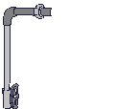
Similar Outfall
What is a similar outfall?
  similar effluents based on a consideration of industrial activity, significant materials and management practices, and activities within the area drained by the outfall.
The permittee may sample only the discharge point (outfall) with the highest concentration of pollutants, but must include documentation in SWPPP.

Slide 45
Sampling Procedures
Measurable Storm Events - a storm event that results in an actual discharge from the site that follows the preceding measurable storm event by at least 72 hours (3 days).
Grab Sample – must be taken within the first 30 minutes of a discharge resulting from a measurable storm event. If it is not possible to collect the sample within the first 30 minutes of a measurable storm event, the sample must be collected as soon as practicable.

Slide 46


Adverse Weather Conditions
When adverse weather conditions prevent the collection of samples according to the relevant monitoring schedule, a sample can be taken during the next qualifying storm event.

Slide 47
Parameter Benchmark Values
Same as previous permit
Except for 6 Metals
        Cadmium
        Copper
        Lead
        Nickel
        Silver
        Zinc

Slide 48
Discharge Monitoring Reports
Submit monitoring results obtained from the previous twelve (12) months on Discharge Monitoring Report (DMR) Forms
Reports are due by the 31st day of January each year for the previous January – December reporting period (i.e. January 31, 2011 for Year 2010)
Make sure DMR’s are signed by the proper official

